Slide 1
Digital portfolio
Student Name : Vignesh.G
Register No and NMID: 222403566/40D4789620219D882854E585A1482
Department :Bsc.Computer Science
College : Sridevi Arts&Science College at Ponneri/Madras University

Slide 2
ProJECt TItle
Book the Trip

Slide 3
agenda
1.ProblemStatement
2. Project Overview
3. EndUsers
4. Tools and Technologies
5. Portfolio design and Layout
6. Features and Functionality
7. Results and Screenshots
8. Conclusion
9. Github Lin

Slide 4
Problem statement
Design a Trip Booking Form using HTML, CSS, and JavaScript where users can enter their details (name, email, destination, date, and number of persons) to book a trip. On form submission, display a confirmation message and reset the form.

Slide 5
Project OVERVIEW
This project is a simple Trip Booking Form created using HTML, CSS, and JavaScript. It allows users to enter details like name, email, destination, date, and number of persons. On submission, it validates the inputs, shows a confirmation message, and resets the form. The design is clean, user-friendly, and responsive.

Slide 6
WHO ARE THE END USERS?
The end users of this project are:Travelers / Customers – who want to book trips online easily.Travel Agencies – who can use this form to collect booking details from customers.

Slide 7
TOOLS AND TECHNIQUES
Tools Used:
-Visual Studio Code (VS Code): for writing and editing the code.
-Web Browser (Chrome/Edge/Firefox): for testing and running the project.a
Techniques Applied:
-HTML5 Form Elements: to collect user inputs (text, email, date, number, dropdown).
-CSS3 Styling: to create a clean, modern, and responsive form design.
-JavaScript (DOM Manipulation & Event Handling):Preventing page reload on form submission.
Validating input fields.
-Displaying a dynamic confirmation message.Resetting the form after submission.

Slide 8
POTFOLIO DESIGN AND LAYOUT
The Trip Booking Form is designed with a clean and simple layout. The form is centered on the page with rounded corners and a shadow effect to make it stand out. Input fields and dropdowns are arranged neatly with proper labels for clarity. The blue “Book Now” button adds interactivity with a hover effect. After submission, a green confirmation message is displayed below the form. The design is user-friendly, responsive, and visually appealing.

Slide 9
Features and functionality
*Features
~Collects Full Name, Email, Destination, Arrival Date, and Number of Persons.
~Uses required validation for all fields.
~Clean and responsive CSS styling with hover effects.
*Functionality
~Prevents empty or invalid submissions.
~On submit, shows a personalized confirmation message.
~Form resets automatically after booking.

Slide 10
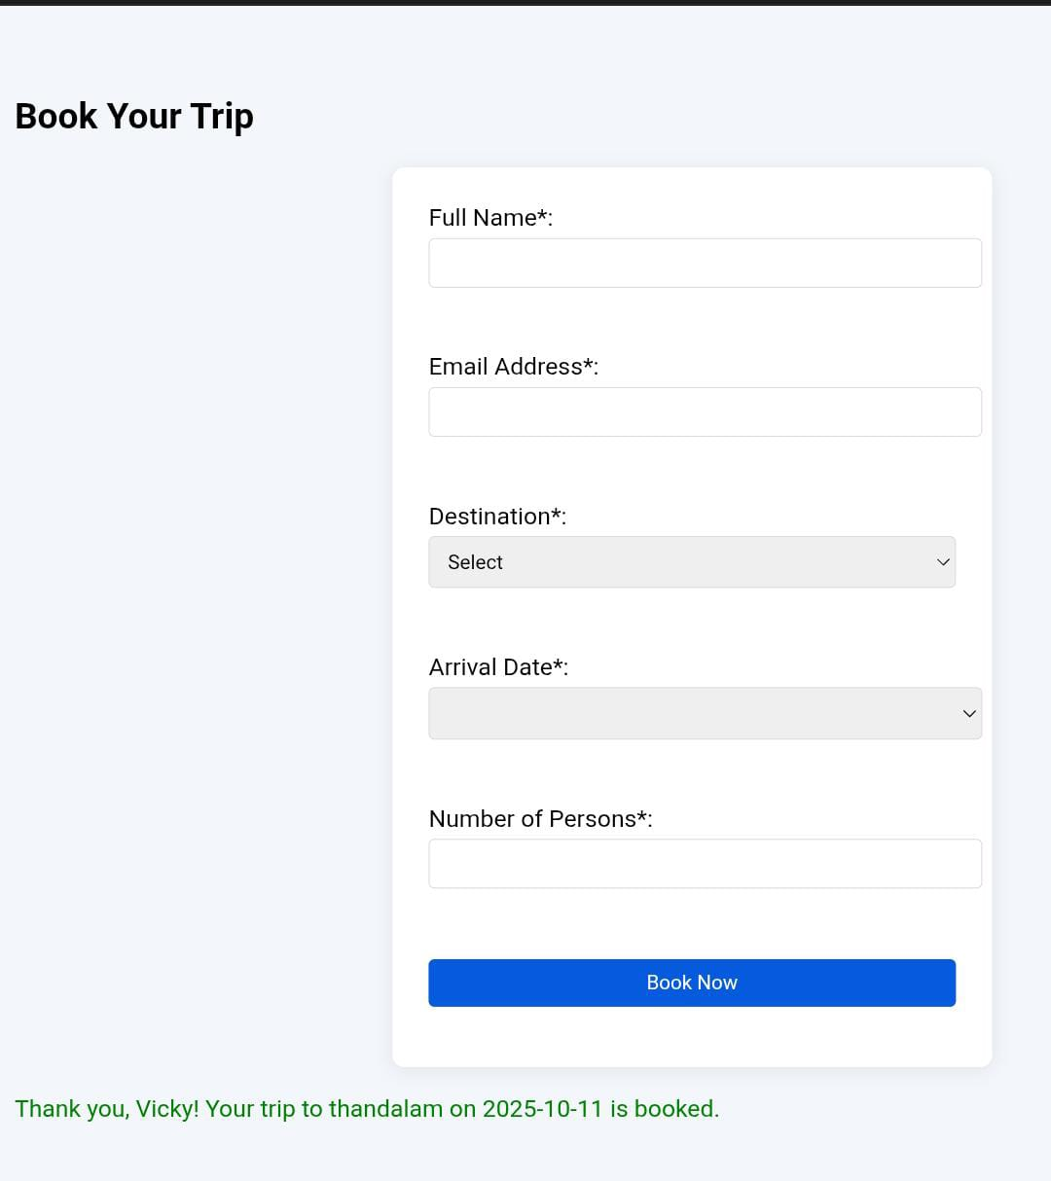
Result and screenshot
Result:
The Trip Booking Form successfully collects user details (name, email, destination, date, and guests) and displays a personalized confirmation message after booking.
Screenshot:

Slide 11
conclusion
The Trip Booking Form provides an easy way to collect user travel details and confirm bookings instantly. It ensures validation, gives immediate feedback, and enhances the user experience with a simple, interactive design.

Slide 12
GITHUB LINK
https://github.com/gvignesh24112bsccs-collab/Vignesh-24112.git

